Slide 1

TRIBHUVAN UNIVERSITY
Faculty of humanities and social science
Ratna Rajya Laxmi Campus
Exhibition Road, Kathmandu
Music Library Platform
Submitted by
Bisham Raj Pandey-15 Bishal Regmi-14
Submitted to
Department of Computer Application
Ratna Rajyalaxmi Campus

Slide 2
Introduction
The platform allows users to listen to music and interact with it by liking or disliking tracks.
Users can create personalized playlists from the songs they’ve liked.
Artists can upload their music and specify preview segments to showcase specific parts of their tracks.
The system includes a recommendation algorithm that tailors song suggestions based on user preferences and interactions.

Slide 3
Problem Statement
Short Attention Spans and Song Previewing Needs.
Lack of Personalized Recommendations
Limited User Interaction with Music
Difficulty in Managing Playlists

Slide 4
Objectives
Develop a user-friendly music streaming platform
Implement a customizable preview system
Build a recommendation algorithm

Slide 5
Requirement Analysis
Problems of current systems
Music recommendations are often generic and fail to adapt to user preferences.
Users struggle to find new music that matches their tastes.
Playlist creation can be tedious, with too many options and no personalized filtering.
Advantages of Proposed system
The recommendation system adapts in real-time based on user interactions.
Users can easily curate playlists from songs they have already liked.
The preview system helps users quickly decide if they enjoy a song.

Slide 6
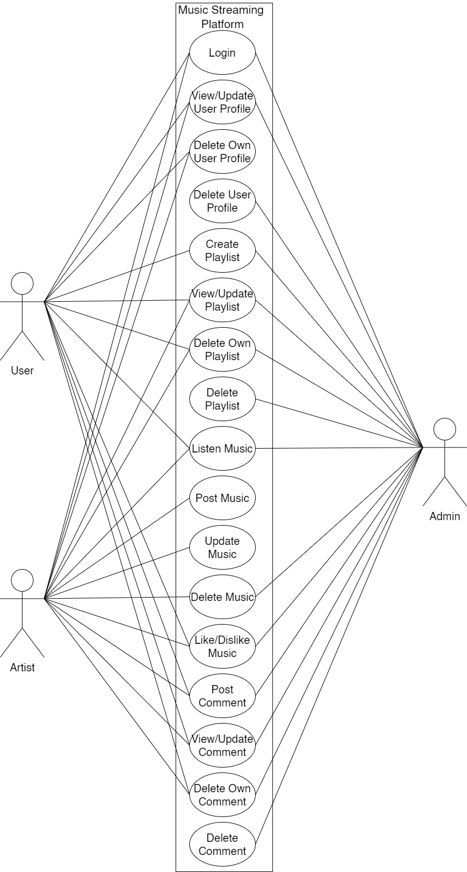
Use-Case Diagram

Slide 7
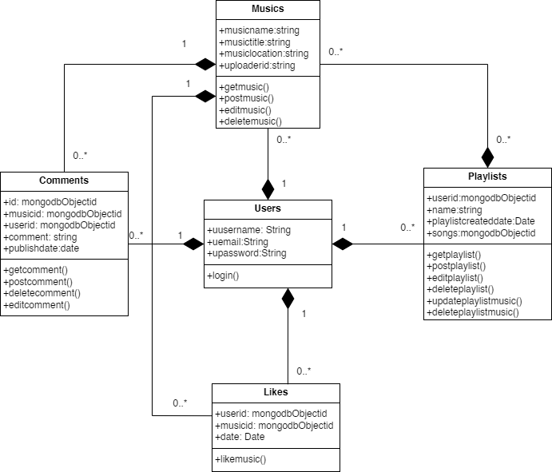
Class Diagram

Slide 8
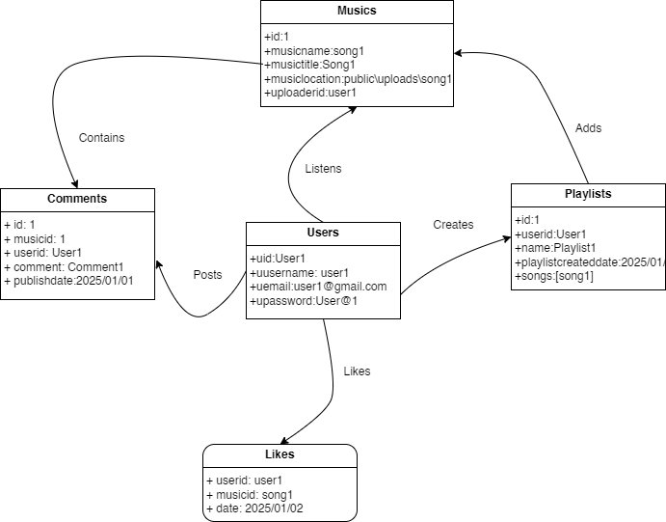
Object Diagram

Slide 9
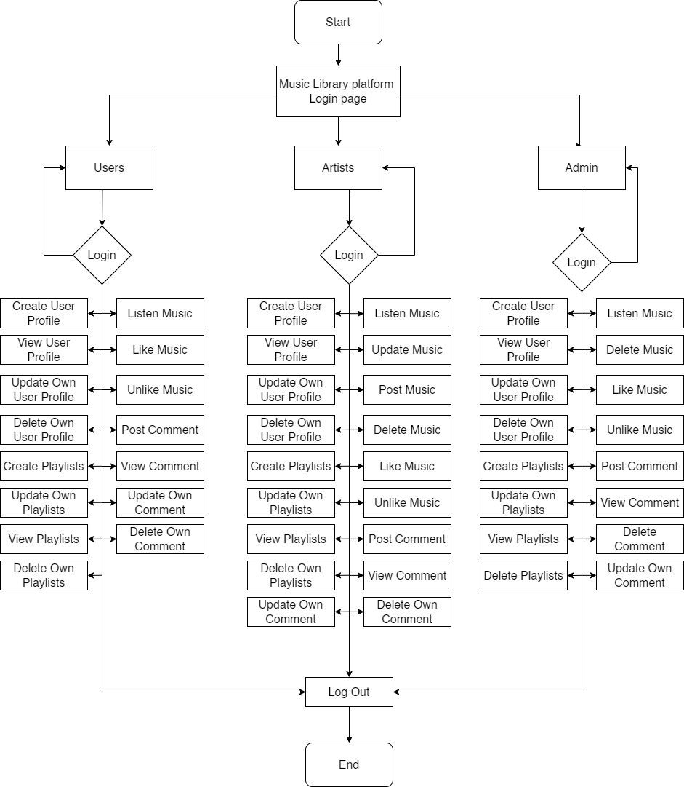
State Diagram

Slide 10
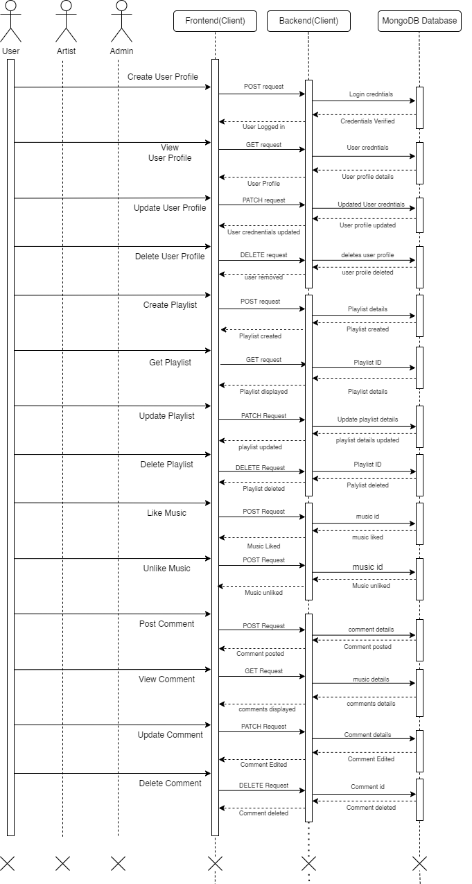
Sequence Diagram

Slide 11
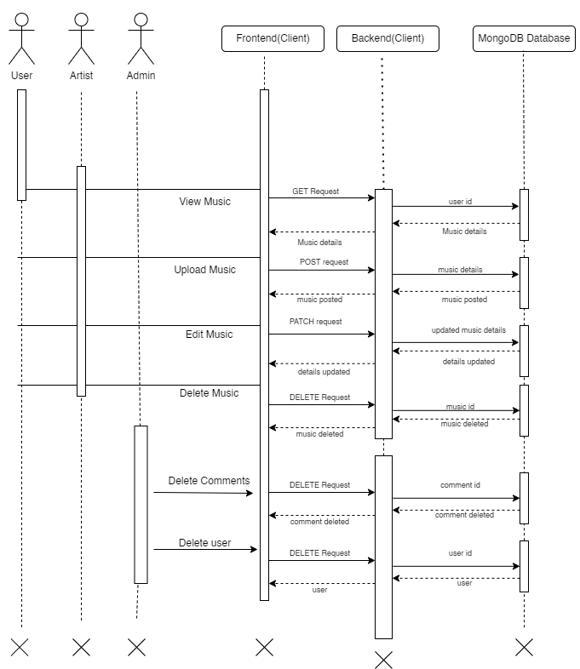
Sequence Diagram

Slide 12
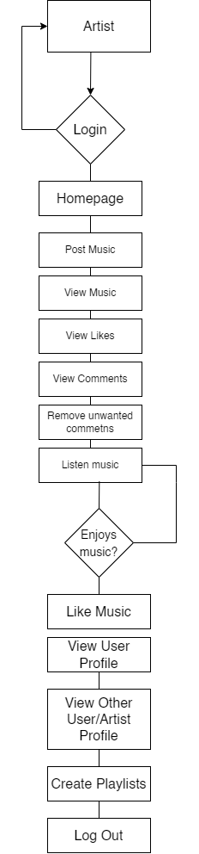
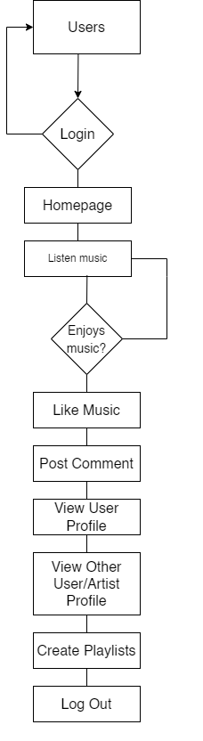
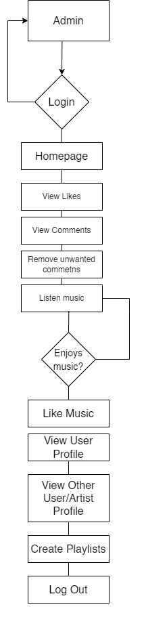
Activity Diagram

Slide 13
Algorithm
Epsilon Greedy
Logic
- Best-known arm with probability (1 - ε)
- Random arm with probability (ε)
Working
ε (epsilon): A small number like 0.1 or 0.05
(1 - ε): High chance to exploit the best arm so far
ε: Small chance to explore other arms randomly
You keep track of average rewards for each arm, then:
With 90% chance → pick the arm with highest average
With 10% chance → pick a random arm

Slide 14
Algorithm
Advantages:
Simple and fast to implement
Guarantees some exploration, avoiding getting stuck on a bad choice
Works well when ε is tuned properly
Disadvantages:
Exploration is random, not strategic
ε value must be carefully chosen (too high = too random, too low = not enough exploration)
Doesn’t adapt over time unless ε is decayed (not automatic)

Slide 15

Algorithm
Upper Confidence Bound 1(UCB1)
Formula
Where,
n = total number of times all arms have been pulled (explored)
𝑛𝑖n i​ = number of times arm 𝑖i has been pulled
ln⁡= natural logarithm

Slide 16
Algorithm
Advantages:
Smart exploration: prefers less tried arms with potential
No need for tuning (like ε)
More efficient long-term performance
Mathematically grounded
Disadvantages:
More complex than ε-greedy
Needs accurate tracking of counts and averages
Can be slower to compute in real-time if many arms)

Slide 17
References
[1] J. Daher, 18 11 2023. [Online]. Available: https://www.thedartmouth.com/article/2023/09/trends-shorter-songs. [Accessed 25 2 2025].
[2] S. Bludov, "www.dataart.com," 12 2019. [Online]. Available: https://www.dataart.com/media/3234/shortening-attenting-spans-sb.pdf. [Accessed 23 2 2025].
[3] S. Stella, "publicknowledge.org," 9 3 2023. [Online]. Available: https://publicknowledge.org/new-public-knowledge-paper-shines-a-light-on-the-broken-music-streaming-industry. [Accessed 9 3 2023].
[4] J. Shotwell, "https://artists.bandsintown.com/," [Online]. Available: https://artists.bandsintown.com/support/blog/short-attention-spans-are-dramatically-altering-songwriting-heres-how. [Accessed 25 2 2025].
[5] "www.sharetopros.com/," 16 8 2023. [Online]. Available: https://www.sharetopros.com/blog/the-challenges-and-obstacles-facing-the-music-industry-today.php. [Accessed 25 2 2025].

Slide 18
Thank
You

